Slide 1




Design and Simulation of 8 bit Signed Binary Number Representation Using Two's Complement Method
Using Two's Complement Method in Logisim Digital Logic Simulator
COURSE / EVALUATION
DELIVERABLES
TEAM MEMBERS:
VARUN CHOUDHARY_2620030156
Kapil Akash 2620030182
RupaSree 2620030185
Bhanu Shanker
Digital Logic Design Lab
Logisim Model + GitHub + Viva

Slide 2


Problem Statement
Need for Two's Complement
Sign-Magnitude Limitation: Standard sign-magnitude systems have dual zeros (+0 and -0) and require complex arithmetic hardware logic.
Project Objectives
1. Design a hardware-efficient 8-bit Two's Complement generator in Logisim.
Two's Complement Solution: Eliminates double-zero ambiguity and enables subtraction using standard adder circuits.
2. Simulate negative number generation and 8-bit signed addition/subtraction.
8-Bit Range Specification: Represents signed integers from -128 to +127 with MSB acting as the sign bit (0 = +, 1 = -).
3. Verify overflow conditions and bit-level accuracy across boundary test vectors.

Slide 3




Design & Methodology
1. Inversion (1's Comp)
2. Increment (+1 LSB)
Pass the 8-bit binary input through NOT gates (inverters) to complement all individual bits (0 → 1, 1 → 0).
Add 1 to the Least Significant Bit (LSB) using a cascaded Full Adder network with Carry-In = 1 to obtain 2's Complement.
Mathematical Formula

Slide 4
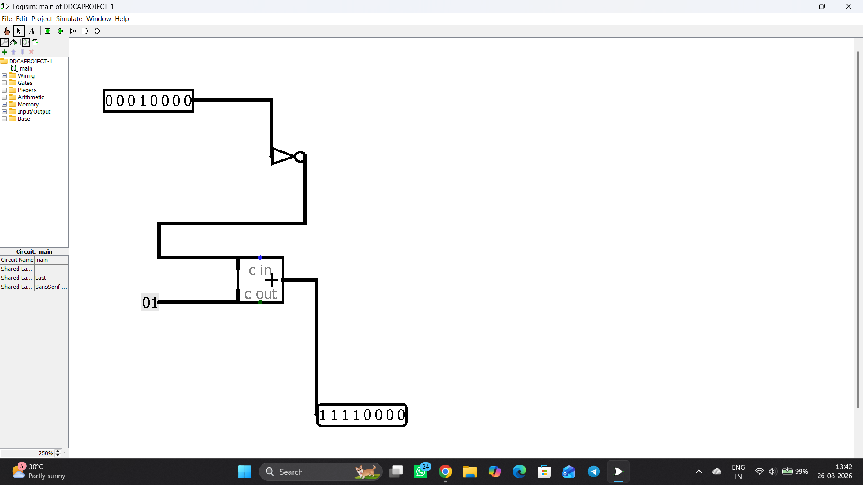

Logisim Circuit & Demo
Simulation Setup
8-Bit Input Pins: User enters 8-bit binary numbers interactively.
Adder Circuitry: 8-bit Parallel Carry Adder built using Full Adders.
Sample Verification: +8 (00001000)→ -8 (11111000)

Slide 5

.

